Slide 1
Documentum LDAP Demo
Daisy Wu
December 6th, 2007

Slide 2
Agenda
What is LDAP?
Enable LDAP authentication in Documentum
How Documentum Content Server authenticate users against LDAP
Troubleshoot Documentum authentication problem
Demo
Questions and answers

Slide 3
What is LDAP?
LDAP = Lightweight Directory Access Protocol
LDAP is based on a client-server model. Client makes a TCP connection to an LDAP server, sends requests and receives responses.
LDAP information model is based on LDAP entries. Entries contain information about objects (e.g., a person).
LDAP entries are organized in tree structure, usually based on geographical or organizational boundaries.
LDAP entries are composed of attributes. Attributes have types. Each attribute can have one or more values.
Each LDAP entry is uniquely identified by its Distinguished Name (aka DN).
LDAP is fast on “read” (search), slow on “write” (store).
Documentum content server 5.3 supports LDAP authentication. It supports these LDAP Vendors:
  Microsoft Active Directory
  SunOne/iPlanet/Netscape Directory Server
  Oracle Internet Directory Server

Slide 4
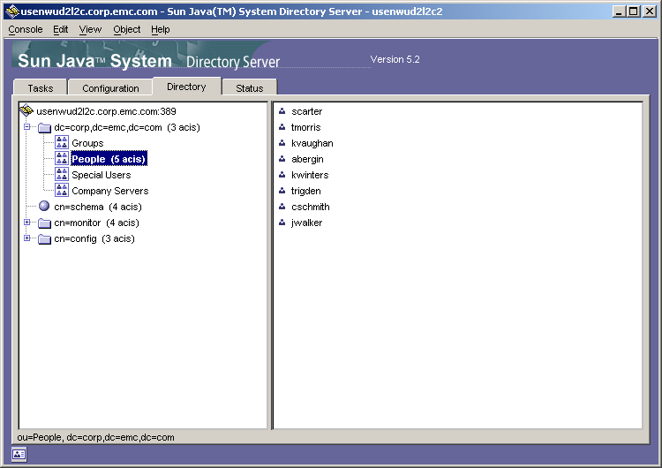
What is LDAP? (continued)

Slide 5
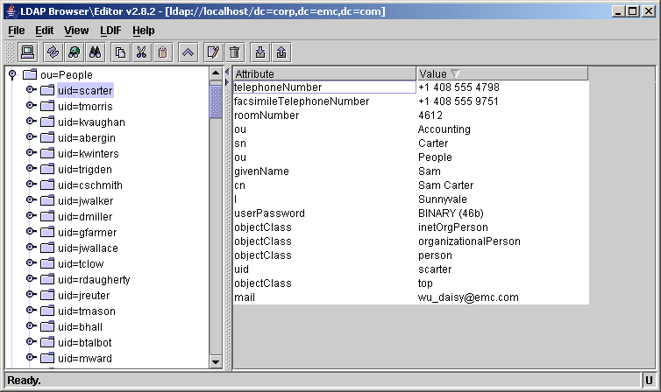
What is LDAP? (continued)

Slide 6
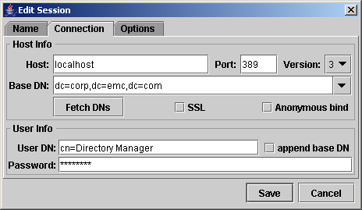
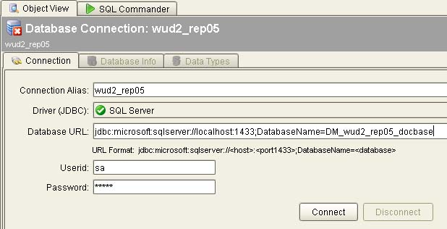
LDAP vs Relational Data Base
LDAP | RDBMS
Connection Host name Port number (default LDAP port is 389) Bind DN (e.g. cn=Directory Manager) Password Authentication method (Simple or SSL) | Connection Host name Port number User Id Password Database name

Slide 7
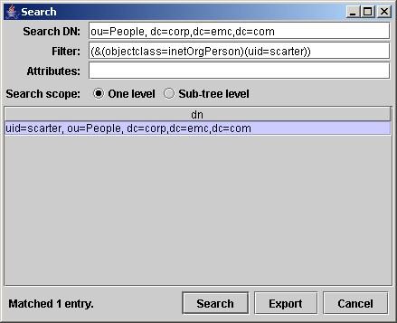
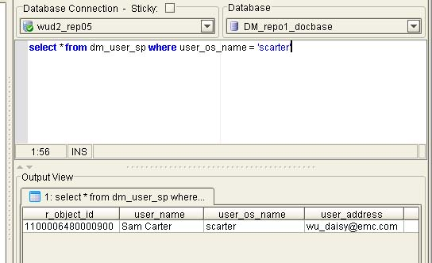
LDAP vs Relational Data Base (Continued)
LDAP | RDBMS
Query Search DN: ou=People, dc=corp,dc=emc,dc=com Filter: (&(objectclass=inetOrgPerson)(uid=scarter)) Scope: One Level or Sub-Tree | Query select * from dm_user_sp where user_os_name = ‘scarter‘

Slide 8
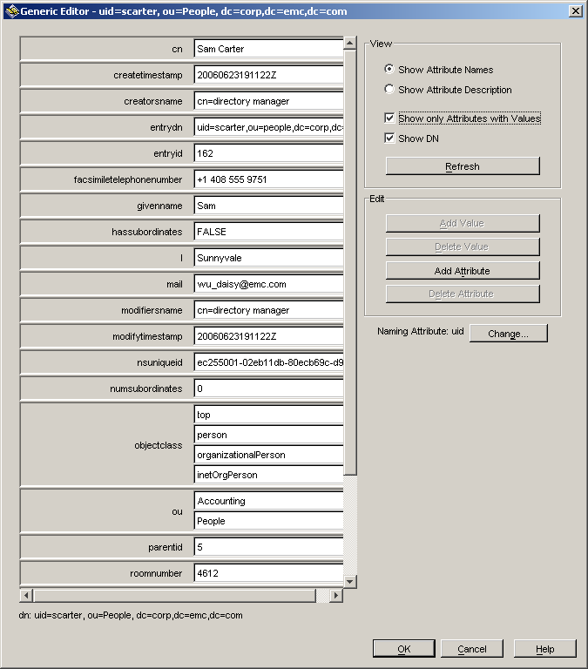
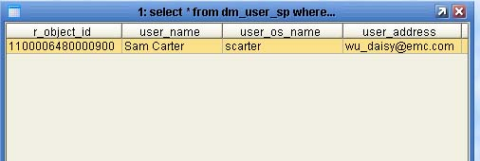
LDAP vs Relational Data Base (Continued)
LDAP | RDBMS
One LDAP Entry: | One DB Row:

Slide 9
Enable LDAP authentication in Documentum
Use DA to configure LDAP in Documentum (that is, create one dm_ldap_config object)
Run job dm_LDAPSynchronization to create LDAP groups and users in docbase
Check job status and job report, verify synchronization of groups and users
Test LDAP user authentication

Slide 10
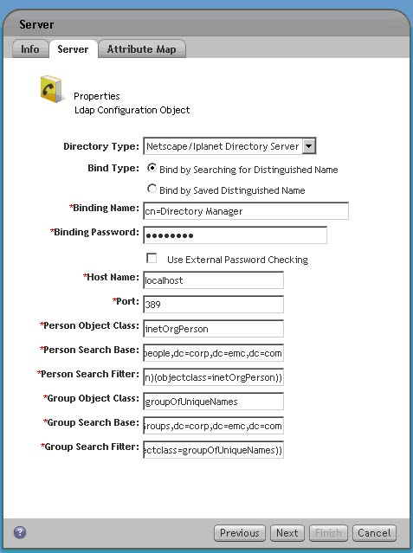
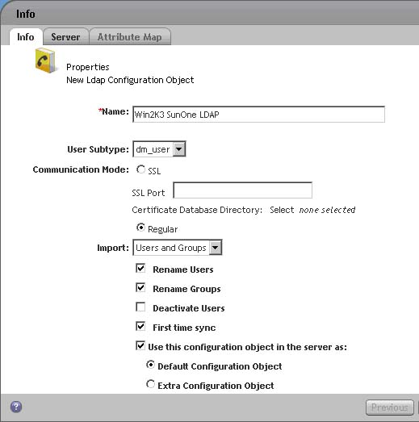
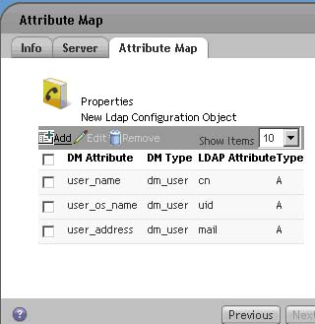
Configure LDAP in Documentum using DA

Slide 11
IAPI command: dump dm_ldap_config object
API> retrieve,c,dm_ldap_config ... 080000648000077e API> dump,c,080000648000077e ... USER ATTRIBUTES object_name : Win2K3 SunOne LDAP title : subject : authors []: <none> keywords []: <none> resolution_label : owner_name : WuD2 owner_permit : 7 group_name : docu group_permit : 5 world_permit : 2 log_entry : acl_domain : WuD2 acl_name : dm_450000648000059e language_code : map_attr [0]: user_name [1]: user_os_name [2]: user_address map_val [0]: cn [1]: uid [2]: mail map_attr_type [0]: dm_user [1]: dm_user [2]: dm_user | map_val_type [0]: A [1]: A [2]: A map_const_attr []: <none> map_const_val []: <none> ldap_host : localhost port_number : 389 person_obj_class : inetOrgPerson group_obj_class : groupOfUniqueNames per_search_base : ou=people,dc=corp,dc=emc,dc=com grp_search_base : ou=Groups,dc=corp,dc=emc,dc=com per_search_filter : (&(objectclass=top)(objectclass=organiza tionalPerson)(objectclass=person)(object class=inetOrgPerson)) grp_search_filter : (&(objectclass=top)(objectclass=groupOfU niqueNames)) bind_dn : cn=Directory Manager bind_pwd : user_subtype : dm_user rename_user_option : T deactivate_user_option : F rename_group_option : T import_mode : both bind_type : bind_search_dn use_ext_auth_prog : F ssl_mode : 0 ssl_port : 0 certdb_location : first_time_sync : F

Slide 12
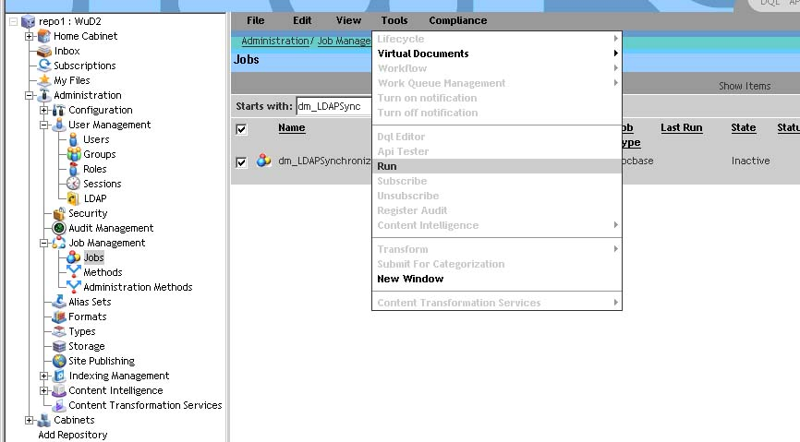
Run job dm_LDAPSynchronization
DA > Administration > Job Management > Jobs (search for dm_LDAPSync)

Slide 13
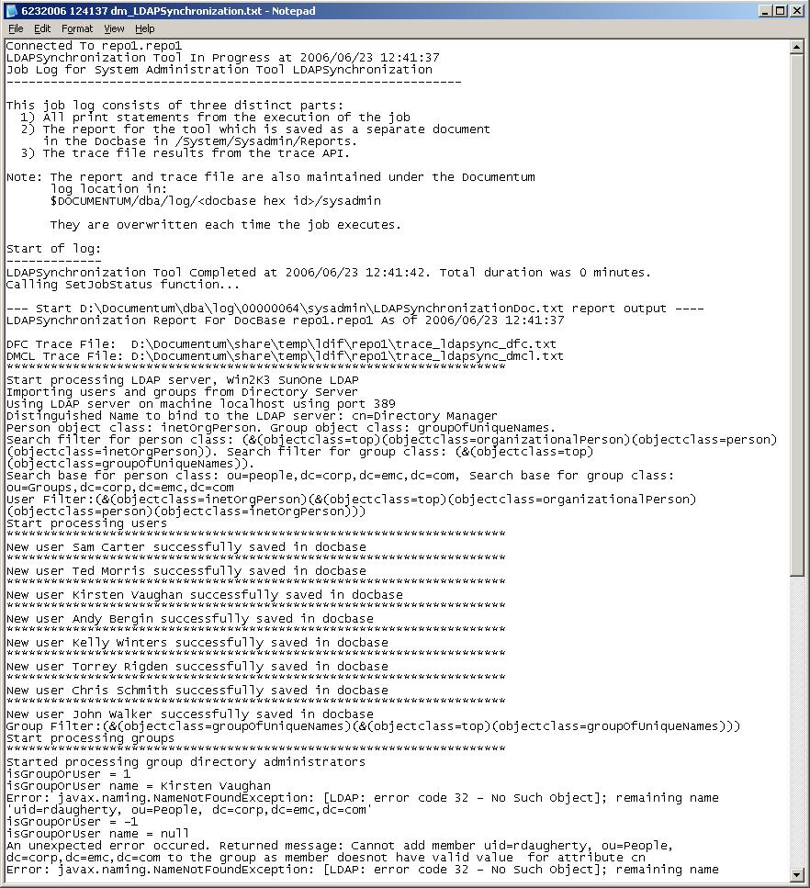
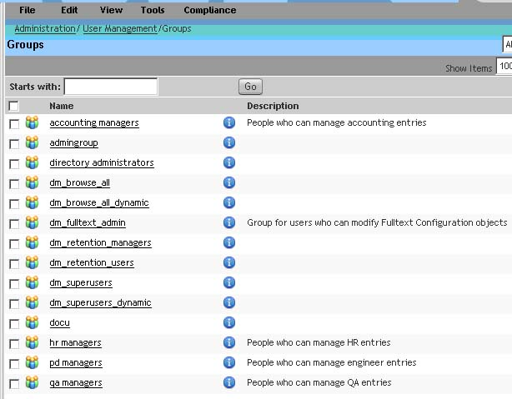
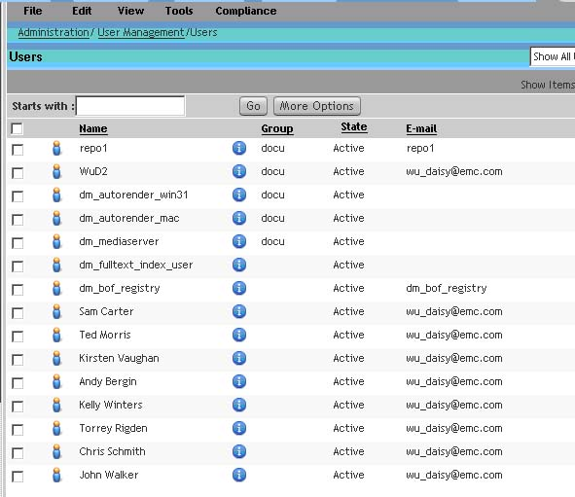
Check job status/log, verify groups and users created successfully.

Slide 14
How Documentum Content Server authenticate users against LDAP
If logged in user’s dm_user object “user_source” attribute is “LDAP”, then perform LDAP authentication.
Based on dm_user’s “user_login_domain” attribute value, retrieve the associated dm_ldap_config object from docbase.
If the newly retrieved dm_ldap_config object is configured to connect to LDAP server over SSL, get the file path to server certification store (path to certificate store is indicated by attribute “certdb_location” in dm_ldap_config object). Create/initialize ldap_handle using the certificate store, “ldap_host” and “port_number” defined in dm_ldap_config object
For non-SSL configuration, ldap_handle is created/initialized using “ldap_host” and “port_number” (skip certificate store).
If the “bind_type” in dm_ldap_config is “bind_search_dn”, then the follow would take place:
  Check to see if “bind_pwd” attribute in dm_ldap_config object is empty, if not, decrypt the “bind_pwd” value.
  Otherwise, retrieve LDAP bind password file from content server’s file system. File path to password file is attribute value of “file_system_path” of “dm_location” object where object_name=’config’) + docbasename + ldap_<ldap_config_id>.cnt
  Open and read password file, decrypt the LDAP bind password.
  Authenticate against LDAP directory server by calling function ldap_simple_bind_s(), pass the “bind_dn“ and the decrypted bind password to function as parameters.
  If ldap_simple_bind_s() is successful, construct LDAP search filter using LDAP attribute name that is configured to mapped to dm_user’s “user_login_name” (attributes map_attr[i], map_val[i], map_attr_type[i], and map_val_type[i] in dm_ldap_config object).
  In a typical Microsoft Active Directory LDAP config object, dm_user’s “user_login_name” is usually mapped to “sAMAccountName” LDAP attribute, whereas in a SunOne/Netscape LDAP config object, dm_user’s “user_login_name” is usually mapped to “uid”. As a result, the newly constructed LDAP search filter would look something like this “sAMACountName=<logged in user’s login name in auth request>” for searching Microsoft Active Directory, or like this “uid=<logged in user’s login name in auth request>” for searching SunOne/Netscape Directory Server.
  Call “ldap_search_ext_s()” to search for the logged in user’s Distinguished Name (aka DN), pass the search filter, and the “per_search_base” value from dm_ldap_config as function parameters.
  If the LDAP search is successful, get the DN returned from the search. This DN is the logged in user’s DN in LDAP directory. DN uniquely identifies the logged in user’s profile record in the directory server.
If the “bind_type” in dm_ldap_config is “bind_by_dn”, then get the “user_ldap_dn” attribute value from dm_user object directly. Clearly, the advantage of having bind type “bind_by_dn” in dm_ldap_config saves one trip to the LDAP server (we skip one additional ldap_simple_bind_s() and ldap_search_ext_s()) .
Call “ldap_simple_bind_s()” to authenticate against LDAP server using the logged in user’s DN and the password passed in the auth request.
If LDAP authentication succeeds, check if authentication request contain “Application Access Token”, if yes, then proceed to perform application access token validation.
If LDAP authentication fails, call handle login failure function (handle login failure function deactivates the logged in user if the max failed attemps has been reached), then send response back to client application.

Slide 15
Troubleshoot Documentum authentication problem
Due to EMC Product Security Policy restrictions, Documentum Content Server does not reveal to the client application the true cause of authentication failure.
To troubleshoot authentication problem, we can turn on authentication trace on content server
Two ways to enable authentication trace:
Specify the “-otrace_authetication” option at server start up. This option would require restarting the content server.
Run “apply” at IAPI to enable authentication trace on the fly. This option does not require re-starting of the content server.
  # to enable authentication trace
  API> apply,c,NULL,SET_OPTIONS,OPTION,S,trace_authentication,VALUE,B,T
  # to disable authentication trace
  API> apply,c,NULL,SET_OPTIONS,OPTION,S,trace_authentication,VALUE,B,F

Slide 16
Authentication Trace Messages
Wed Dec 5 12:01:11 2007 734484: 8152[8152] AT 8152: Start-AuthenticateUser: ClientHost(pledax.techsupport.dctmlabs.com), LogonName(jsmith), LogonOSName(dmadmin), LogonOSDomain(), UserExtraDomain(), ServerDomain()
Wed Dec 5 12:01:11 2007 735747: 8152[8152] AT 8152: Start-AuthenticateUserName:
Wed Dec 5 12:01:11 2007 736892: 8152[8152] AT 8152: dmResolveNamesForCredentials: auth_protocol()
Wed Dec 5 12:01:11 2007 743117: 8152[8152] AT 8152: End-AuthenticateUserName: dm_user.user_login_domain(ADSSL)
Wed Dec 5 12:01:11 2007 744203: 8152[8152] AT 8152: success
Wed Dec 5 12:01:11 2007 745336: 8152[8152] AT 8152: Found dm_user.user_login_name(jsmith), dm_user.user_login_domain(ADSSL)
Wed Dec 5 12:01:11 2007 746353: 8152[8152] AT 8152: Start-AuthenticateDomain:LogonName(jsmith), UserExtraDomain(), auth_protocol()
Wed Dec 5 12:01:11 2007 747658: 8152[8152] AT 8152: AuthenticateDomain - no domain required:domainOverride(False), user_login_domain(ADSSL), serverAuthTarget(), userAuthTarget()
Wed Dec 5 12:01:11 2007 748709: 8152[8152] AT 8152: End-AuthenticateDomain:
Wed Dec 5 12:01:11 2007 749804: 8152[8152] AT 8152: success
Wed Dec 5 12:01:11 2007 751243: 8152[8152] AT 8152: Start-AuthenticateUserState:UserLoginName(jsmith), UserExtraDomain()
Wed Dec 5 12:01:11 2007 752339: 8152[8152] AT 8152: Start-AuthenticateUserState:
Wed Dec 5 12:01:11 2007 753366: 8152[8152] AT 8152: dmStateForUser: auth_protocol()
Wed Dec 5 12:01:11 2007 754581: 8152[8152] AT 8152: End-AuthenticateUserState:
Wed Dec 5 12:01:11 2007 755589: 8152[8152] AT 8152: success
Wed Dec 5 12:01:11 2007 756751: 8152[8152] AT 8152: Start-AuthenticateByTrust:OSLogonName(dmadmin), UserLoginName(jsmith), OSLogonDomain(), UserExtraDomain()
Wed Dec 5 12:01:11 2007 757870: 8152[8152] AT 8152: End-AuthenticateByTrust:
Wed Dec 5 12:01:11 2007 758862: 8152[8152] AT 8152: failure
Wed Dec 5 12:01:11 2007 759977: 8152[8152] AT 8152: Start-AuthenticateByPassword:UserLoginName(jsmith), UserExtraDomain()
Wed Dec 5 12:01:11 2007 761297: 8152[8152] AT 8152: dmResolveDefaultDomainForLogin: domain(ADSSL), userAuthTarget(), serverProcessDomain()
Wed Dec 5 12:01:11 2007 789209: 8152[8152] AT 8152: Start-authenticateAgainstDirectoryServer: userName = John Smith serverName = rrpvmad.dctmlabs.com portNumber = 389 Search Base = OU=People,OU=documentum,DC=rrpad,DC=com bind_type = bind_search_dn
Wed Dec 5 12:01:11 2007 809411: 8152[8152] AT 8152: ldap_search_ext_s = Success entries = 1 references = 0 messages = 2
Wed Dec 5 12:01:11 2007 810592: 8152[8152] AT 8152: DN = CN=John Smith,OU=People,OU=documentum,DC=rrpad,DC=com
Wed Dec 5 12:01:11 2007 814788: 8152[8152] AT 8152: return value = 49 Invalid credentials
Wed Dec 5 12:01:11 2007 815923: 8152[8152] AT 8152: End-AuthenticateByPassword:
Wed Dec 5 12:01:11 2007 817053: 8152[8152] AT 8152: failure

Slide 17
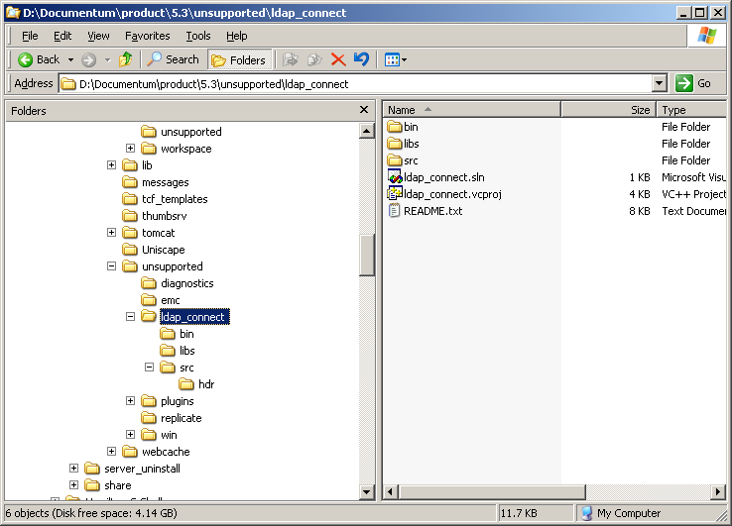
New Tool: ldap_connect
New tool “ldap_connect” will be introduced in 5.3_SP6
“ldap_connect” will be made available under $DM_HOME/unsupported
“ldap_connect” is a stand alone C++ program that mimics EMC Documentum Content Server's LDAP user authentication process (current supported platforms are Windows, Solaris, AIX, HP-UX, HP AI64 and Redhat Linux)
It is intended to be used for troubleshooting LDAP authentication problems

Slide 18
Demo
Run ldap_connect on HP-UX, and Windows (LDAP over SSL and NON-SSL)
Build (compile and link) ldap_connect on HP-UX, and Windows
Attach ldap_connect to debugger on HP-UX, and Windows

Slide 19
Questions and Answers

